Slide 1
E Learning Management System
Project Members :
Muhammad Husnain(20638)
Maaz Tariq(20606)

Slide 2
Introduction
A E- learning management system (LMS) is web-based technology used to plan, implement and assess a specific learning process. It is used for eLearning practices and, in its most common form, consists of two elements: a server that performs the base functionality and a user interface that is operated by instructors, students and administrators.
A E-learning management system provides an instructor with a way to create and deliver content, monitor student participation and assess student performance. A learning management system may also provide students with the ability to use interactive features such as threaded discussions, video conferencing and discussion forums.

Slide 3
Objective
In this new era of electronics, we know the concept of e-learning which does not include the use of paper and pen. There are many advantages of e-learning system. This system also has a responsive design compatible with mobile devices. The system has 3 types of users which are the admin, teachers, and the students. The admin is in charge of maintaining important data such as the list subject, classes, department, and etc. This system can be also useful nowadays which some of the classes are under Modular Distance Learning. Using this system the faculties or teacher can provide soft copies of learning documents to the students and also he/she can create a Practice Quiz and Assignment for a class. Students can answer the teacher's given practice quiz and limited to the teacher's allotted duration for taking the quiz. This is how the new concept of e-learning came into existence, which is an easier and smarter system for colleges.

Slide 4
Feacture
Some common features found in a successful LMS include:
Responsive design - Users should be able to access the LMS from whatever type of device they choose, whether it's a desktop, laptop. The LMS should automatically display the version best suited for the user's chosen device. Additionally, the LMS should also allow users to download content so it is accessible while offline.
User-friendly interface - The user interface (UI) should enable learners to easily navigate the LMS platform. The UI should also align with the abilities and goals of both the user and the organization. An unintuitive UI risks confusing or distracting users and will make the LMS ineffective.
Course and catalog management-The LMS holds all the eLearning subject and the related subject content. Admins and instructors should be able to create and manage these catalogs and subject in order to deliver a more targeted learning experience.
Exams are a great feature to test learners on their knowledge and measure progress. From multiple choice to true or false and more, you’ll be able to experiment with different question types to test your learners.

Slide 5
Modules
Admin
Instructors / Teacher
User / Student

Slide 6
Admin
•Admin can login using credentials
•Add, edit and delete student information
•Add, edit and delete teacher information
•Add an entry like the subject, class , school and calendar
•View log-in trail of every user
View logs of every user activity

Slide 7
Instructors / Teacher
•The teacher can create his/her Class
• View the students for that particular class
•Upload Downloadable materials for his/her class
•Create practice quizzes for students
•Grade students assignment
•Post announcements
•Create a class calendar of events
•Message co-teacher or students

Slide 8
User / Student
•Sign up for his / her account
•Can view classmates in his / her class
•Answer practice quizzes
•View evaluation of assignment and quizzes
•Download downloadable materials in a class
•Upload downloadable material
•Message a teacher or his/ her classmate

Slide 9
Software
•It is smart learning application
•Avoiding paper use
•Time consuming

Slide 10
Language
Html
Css
Bootstrap
Php
Mysql

Slide 11
Software
Windows 10
XAMPP Server
Brackets Editor

Slide 12
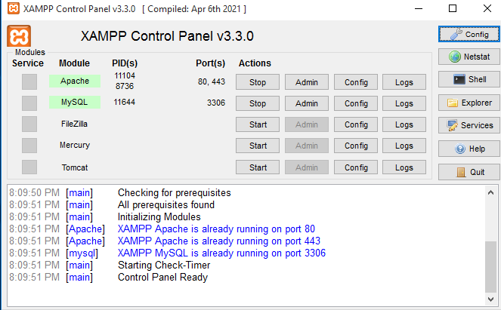
Xampp Server

Slide 13
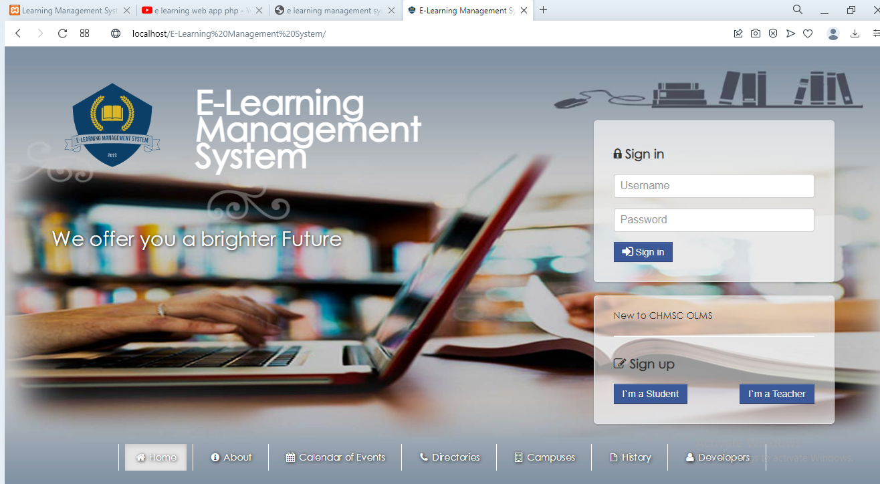
Home Screen

Slide 14
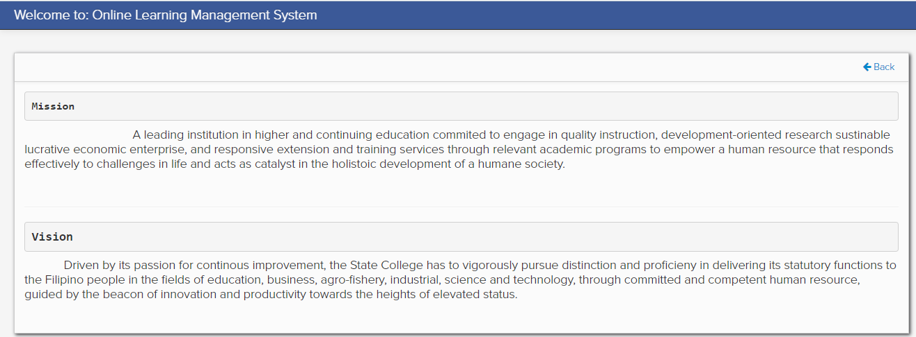
About

Slide 15
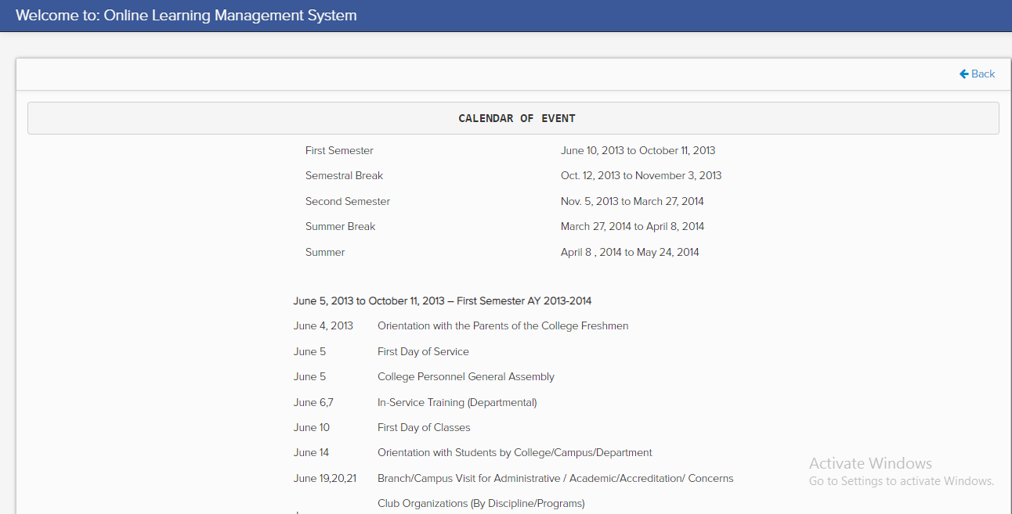
CALENDAR OF EVENT

Slide 16
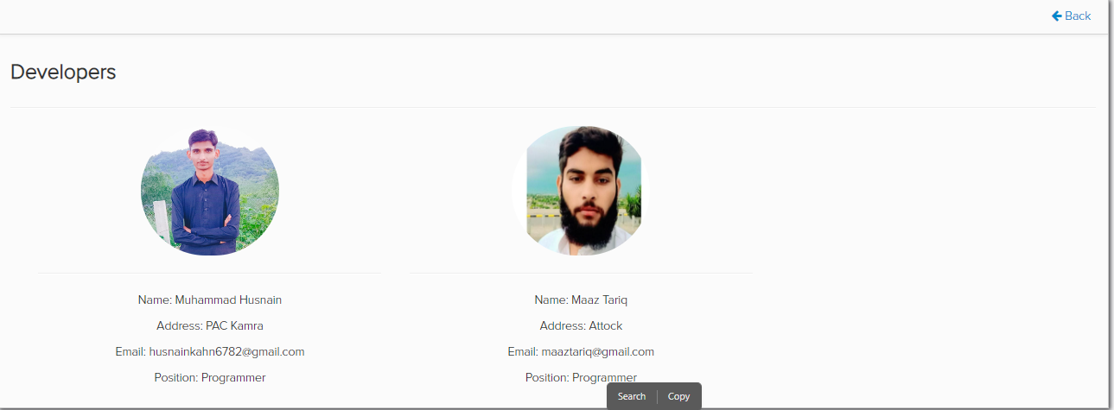
Developers

Slide 17
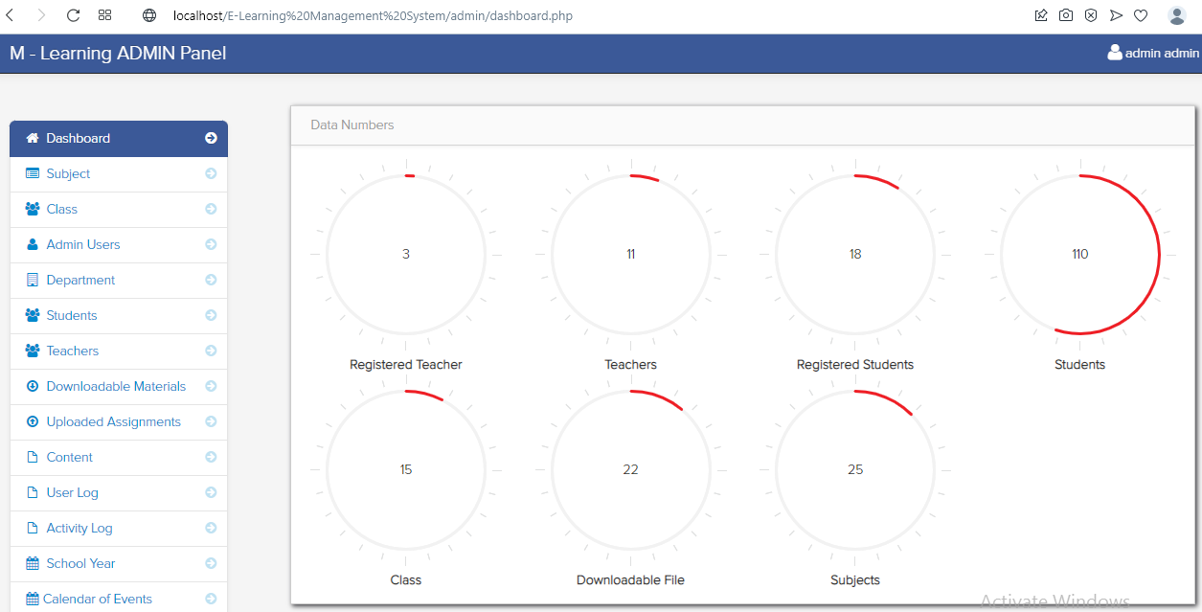
ADMIN Panel

Slide 18
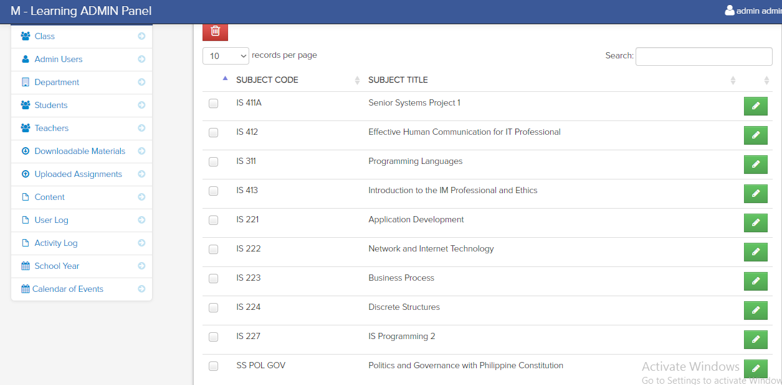
Subject List

Slide 19
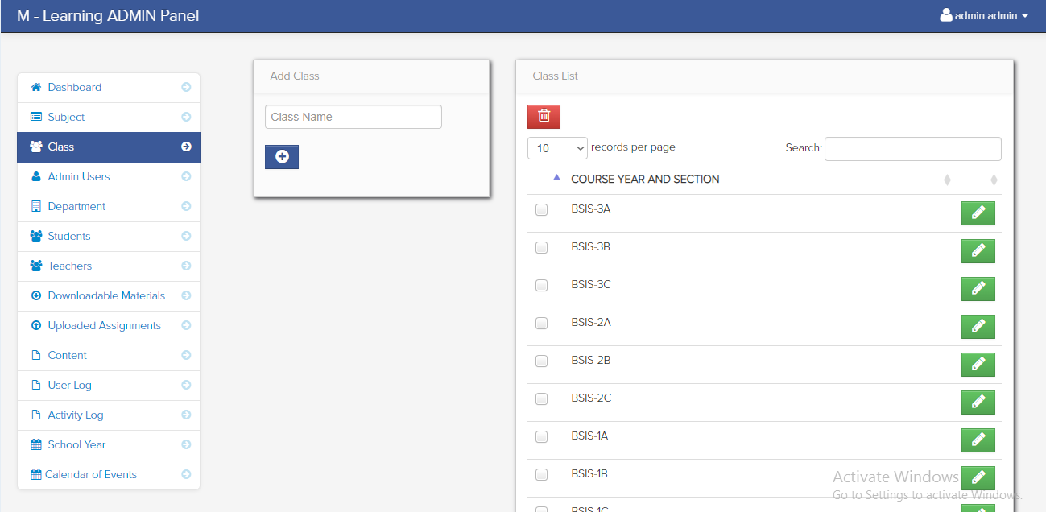
Class List

Slide 20
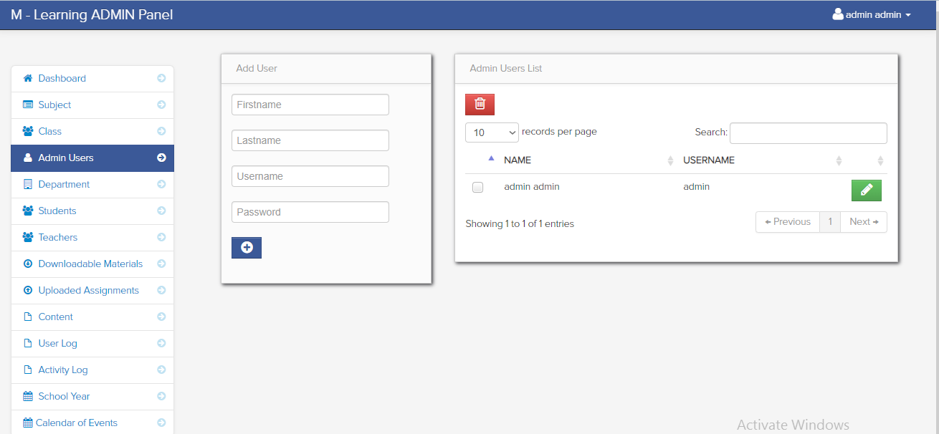
Admin Users List

Slide 21
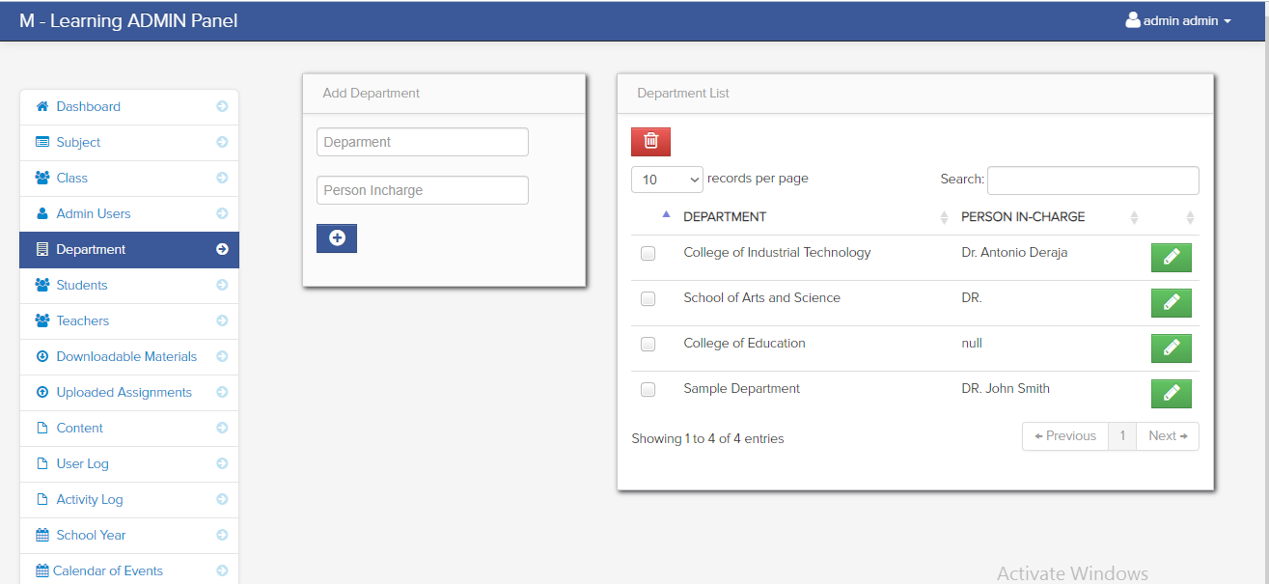
Department List

Slide 22
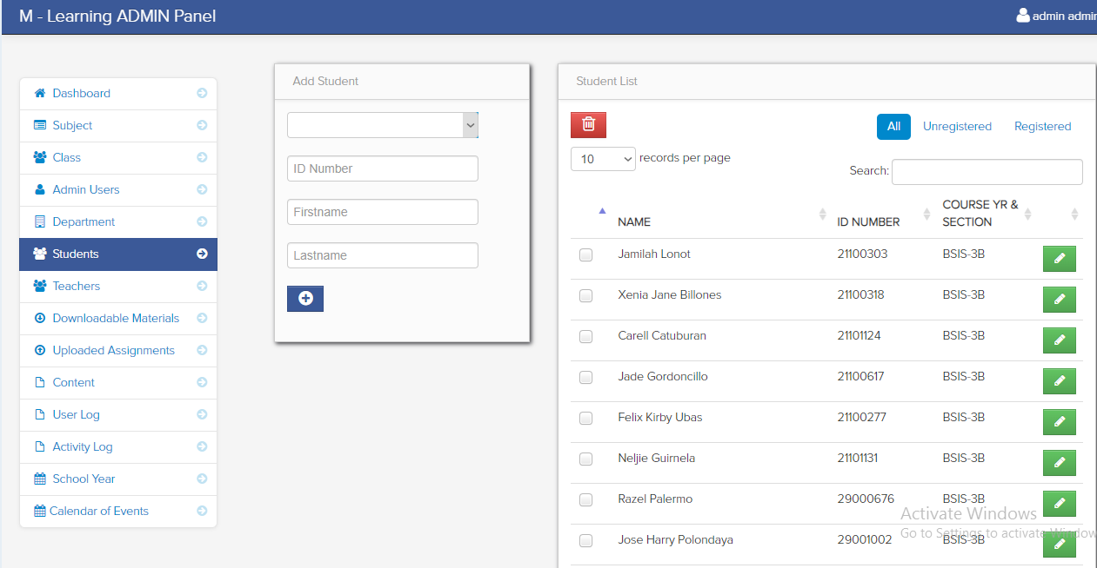
Student List

Slide 23
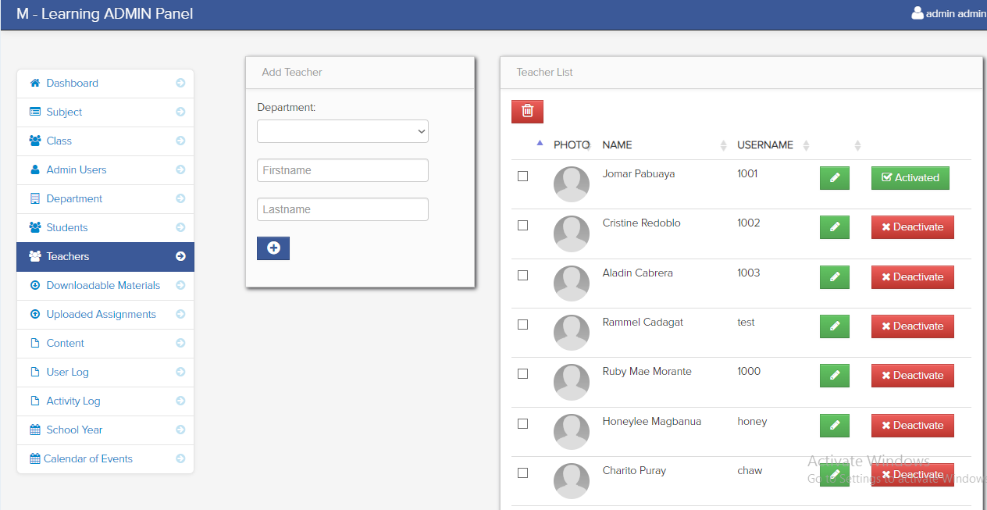
Teacher List

Slide 24
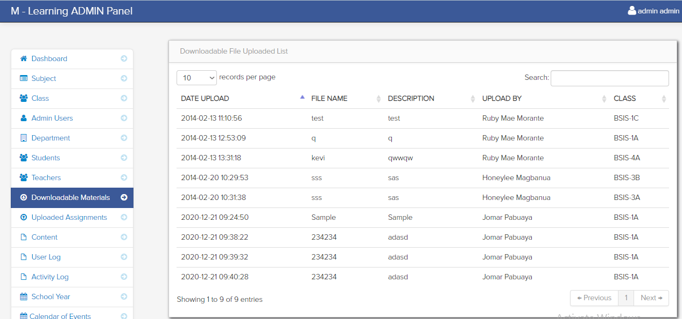
Downloadable File Uploaded List

Slide 25
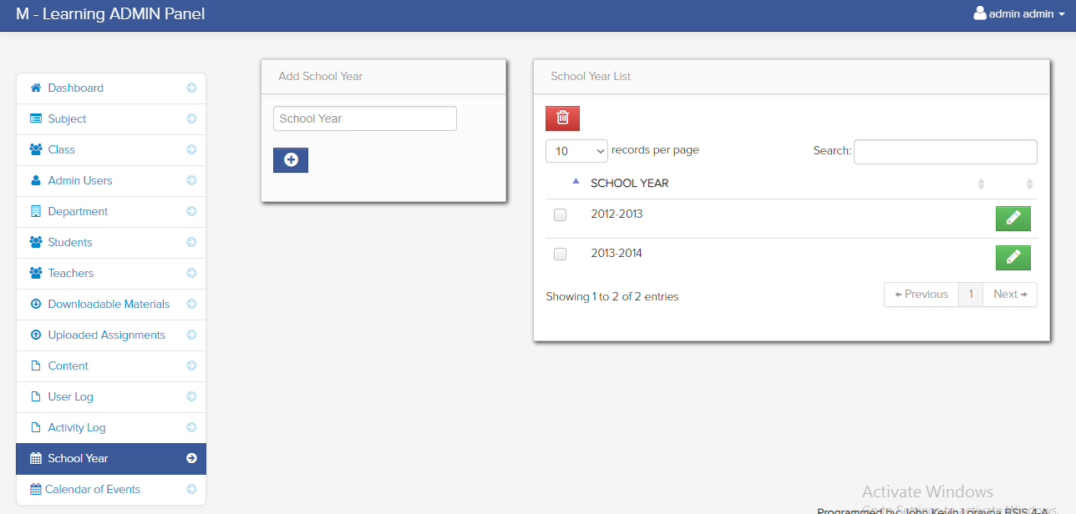
School Year List

Slide 26
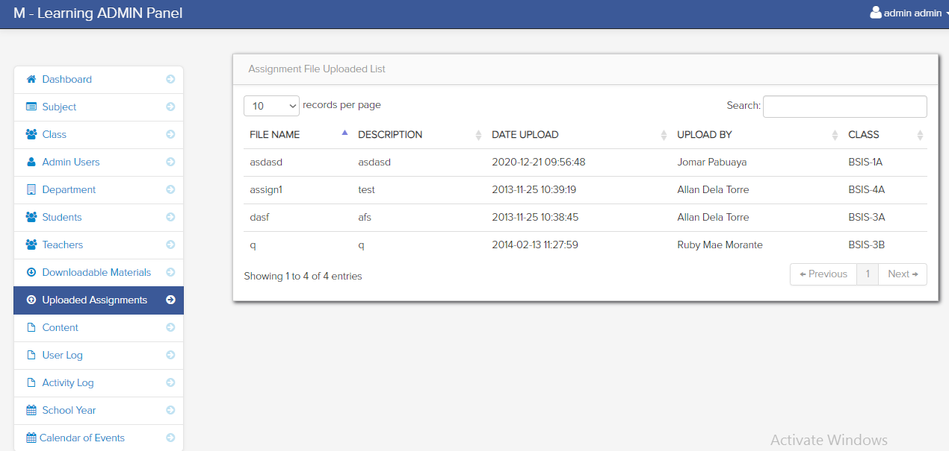
Assignment File Uploaded List

Slide 27
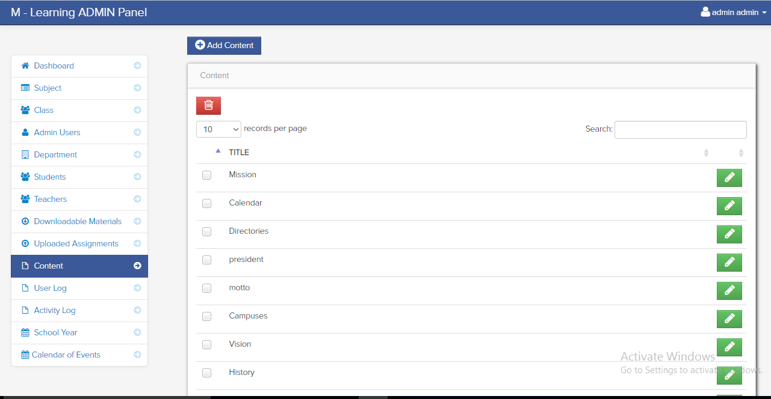
Content

Slide 28
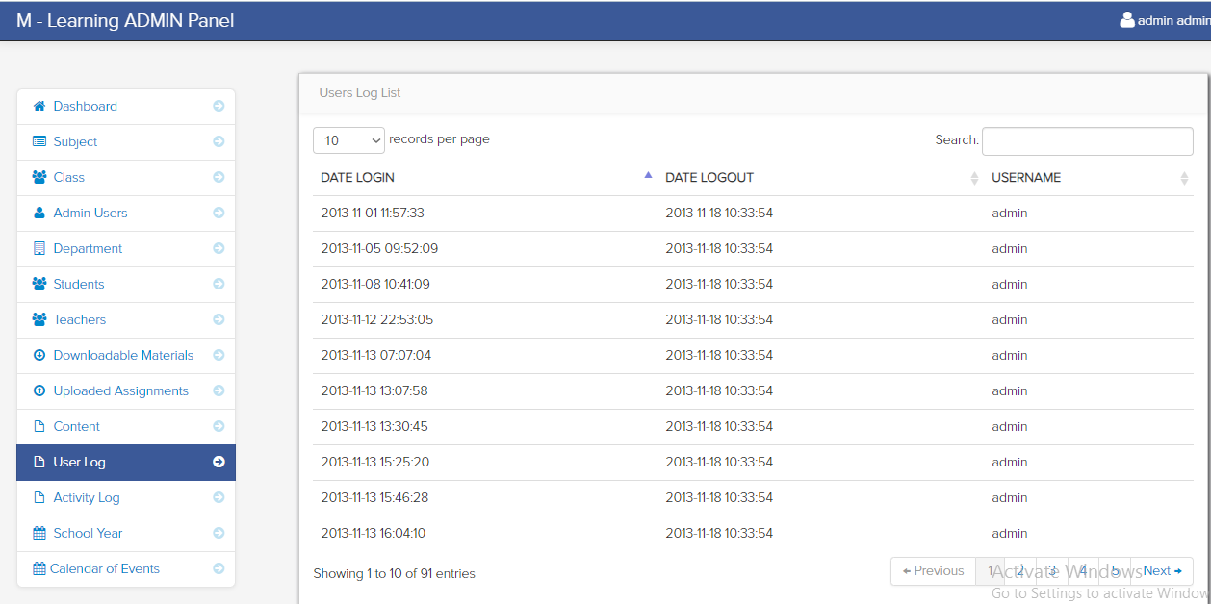
Users Log List

Slide 29
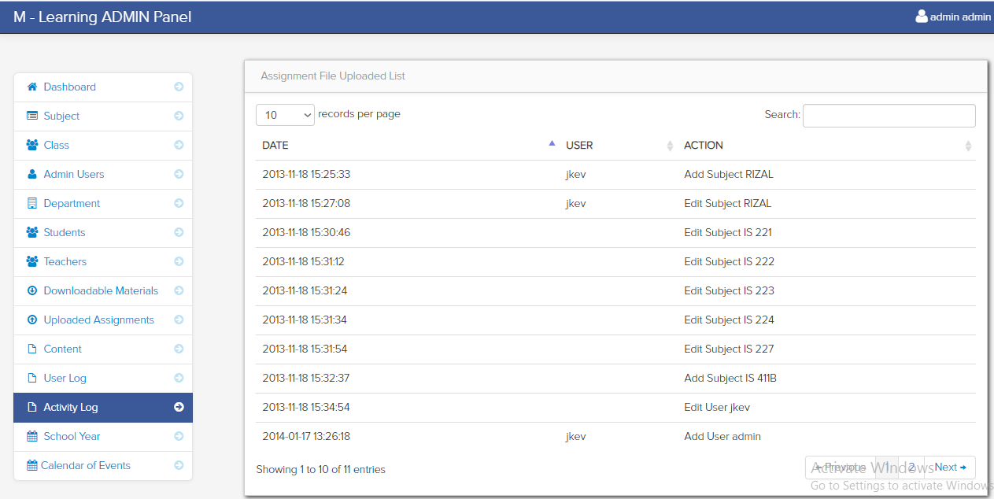
Assignment File Uploaded List

Slide 30
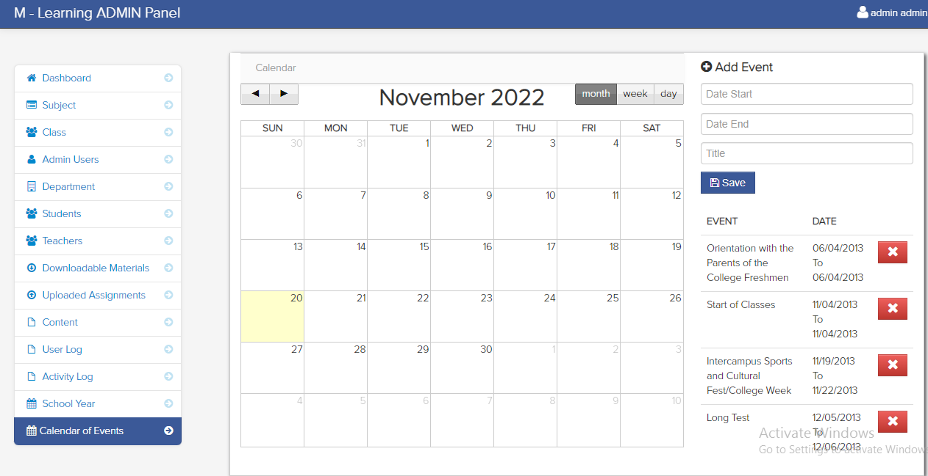
Calendar

